Slide 1
Solomon Branigan
PowerPoint

Slide 2
Vision statement
Our vision is to persuade people in our community to buy pages or a yearbook .

Slide 3
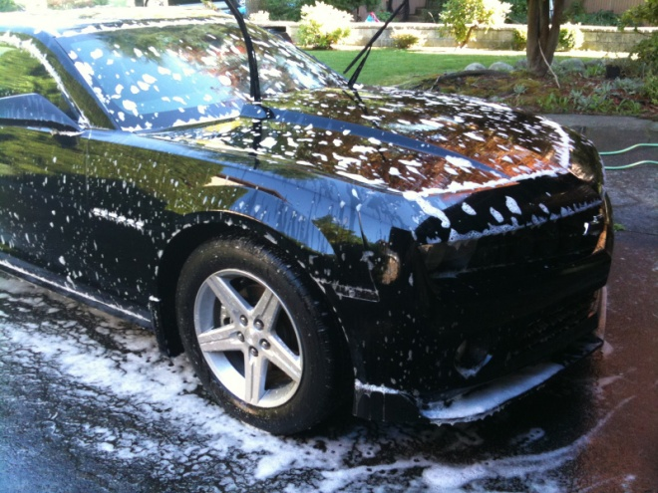
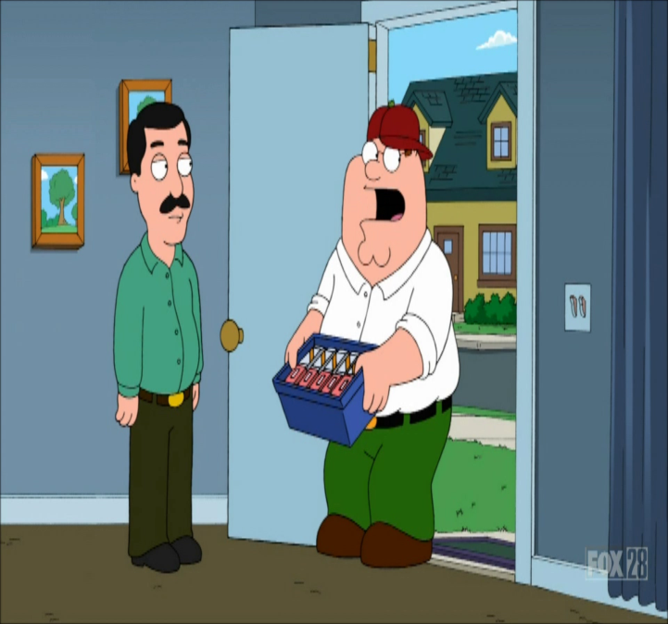
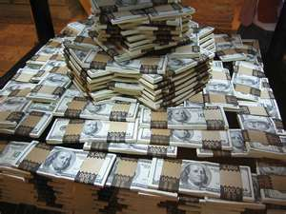
Fundraisers

Slide 4
We made it! Thank you for your appreciation!

